Slide 1
Raster to Vector conversions in the Case of Uncertainty
Cristobal Guerrero
James Schaffer
Department of Electrical and Computer Engineering, Summer 2012

Slide 2
Recap
-Error function was implemented and tested(still being worked on).
-Continued to modify/finish the implementation of a previously described uncertain vector model.
-Some more research was done.

Slide 3
Future Iterations
-Include a method to save points from the vectorized region in either a database or a text file.
-Improve the current vectorizing function that is currently implemented to decrease calculated error.

Slide 4
Calculating probability
-The reason for calculating probability for the uncertain region is to normalize the distance from the core to the support.
-Having a normalized measurement allows for an easy conversion process if using standard measurements.

Slide 5

Probability
f( x,y in core ) = 1
0 < f( x,y in support ) < 1
f( x,y outside object ) = 0

Slide 6
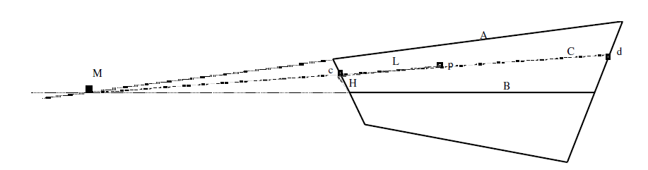
Calculating Probability
-The example above is for calculating the probability when the core of the supported region is not at its center.
-A simple straightforward method of of calculating the probability is as follows:
P(p) = F(ds/ds+dc)
ds - distance to support
dc - distance to core

Slide 7
Calculating Error
-The error calculation checks to see if the probability from the raster is the same as the probability calculated of the vectorized region.
-This is done by encompassing all the points of the raster in a polygon and then checking the probability value at the same point in the vectorized region.

Slide 8
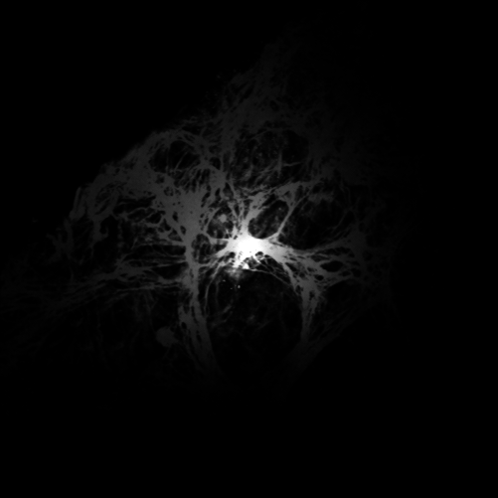
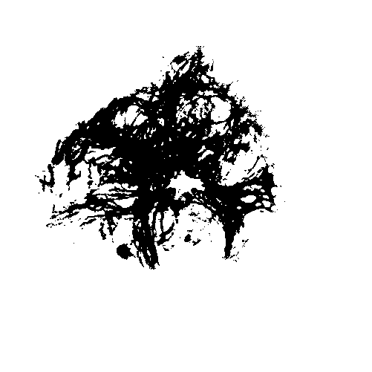
Raster to Raster

Slide 9
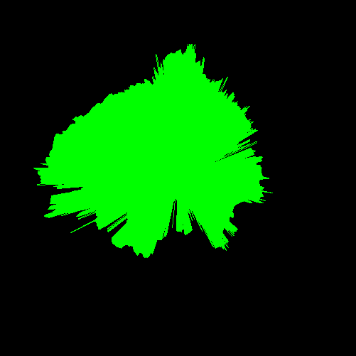
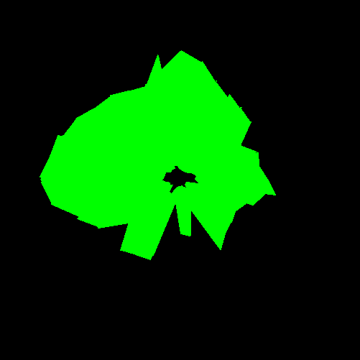
Raster to Vector

